Slide 1
PROFESSIONAL TECHNICAL MANUAL 2022

Slide 2
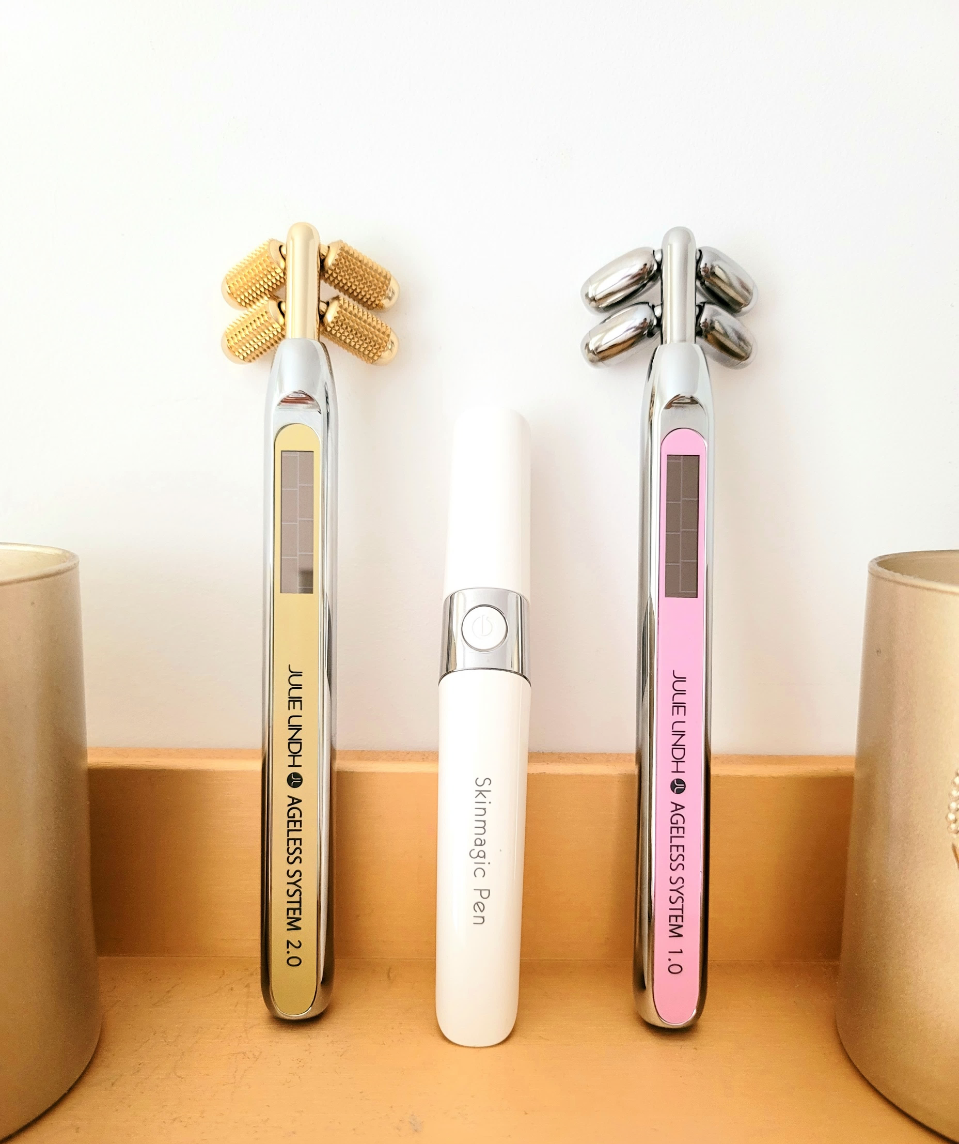
AGELESS
SYSTEM
The Future Of Skin Care

Slide 3
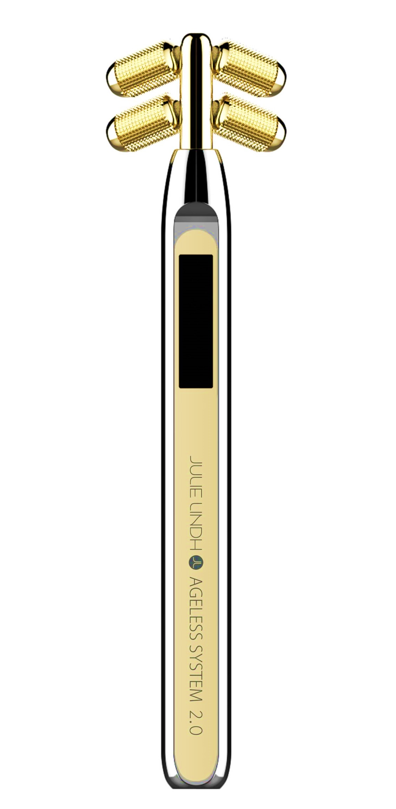
AGELESS BEAUTY WAND
Introducing Japan’s Advance Beauty Technology
14K gold plated
4 smooth rollers
4 spikes rollers
MICROCURRENT
BEAUTY DEVICE
Solar panel
The Ageless System Beauty Wand is a facial micro-current kneading device that will firm and tighten your skin, improve circulation, diminish the appearance of fine lines and wrinkles and help skin care products absorb deeper into the dermis in just 5 minutes a day!
Solar panel
Iron and Copper handle
Iron and Copper handle

Slide 4
AGELESS BEAUTY WAND
Introducing Japan’s Advance Beauty Technology
What is micro-current and how does it work:
Micro-current is like a little workout for your face. Like all the muscles in your body, your facial muscles need a good workout to keep them from sagging and losing definition.
Micro-current devices, such as the Beauty Wand, delivers a low-level electrical stimulation to the top layer of skin and the muscle beneath the skin that helps to tone and tighten the facial muscles. When used properly, micro-current devices stimulate the facial muscles, giving your face a lifted and toned appearance.
Micro-current technology has been used for the past 70 years in the medical field to help patients with Bell’s palsy, a sudden paralysis or weakness of facial muscles, regain control of their facial muscles.
Why this device is unique:
The Beauty Wand is innovative because of its unique design with four rollers that are perfectly spaced to fit the curvatures of the face. The spacing and angle of each roller is precisely placed for hard-to-reach areas like between the eyebrows and around the eyes and mouth.
With time, the rollers can also help to achieve a V-shaped face, often considered a sign of youth. As skin gets older and loses collagen, elasticity, fat, and muscle tone, it begins to sag around the mouth and jowl. The placement of the rollers, along with the muscle-firming and collagen-stimulating benefits of the microcurrent, helps to keep the skin taut, firm, and V-shaped.

Slide 5
AGELESS BEAUTY WAND 1.0
Sustainable Beauty
What does it do?
2-in-1
1. The four rollers massage away puffiness, release tension in the face, and increase blood circulation and oxygen - giving the skin a radiant glow naturally.
2. The micro-current feature helps to firm-up muscle tone and contour the face.
The benefits of 1.0:
Improves circulation
Helps with lymphatic drainage
Reduces puffiness
Tones and tightens the muscles of the face (think lifted jowls and eyebrows)
Shapes and contours the face by improving muscle tone (think contoured jawline)
Reduces the appearance of fine lines and wrinkles

Slide 6
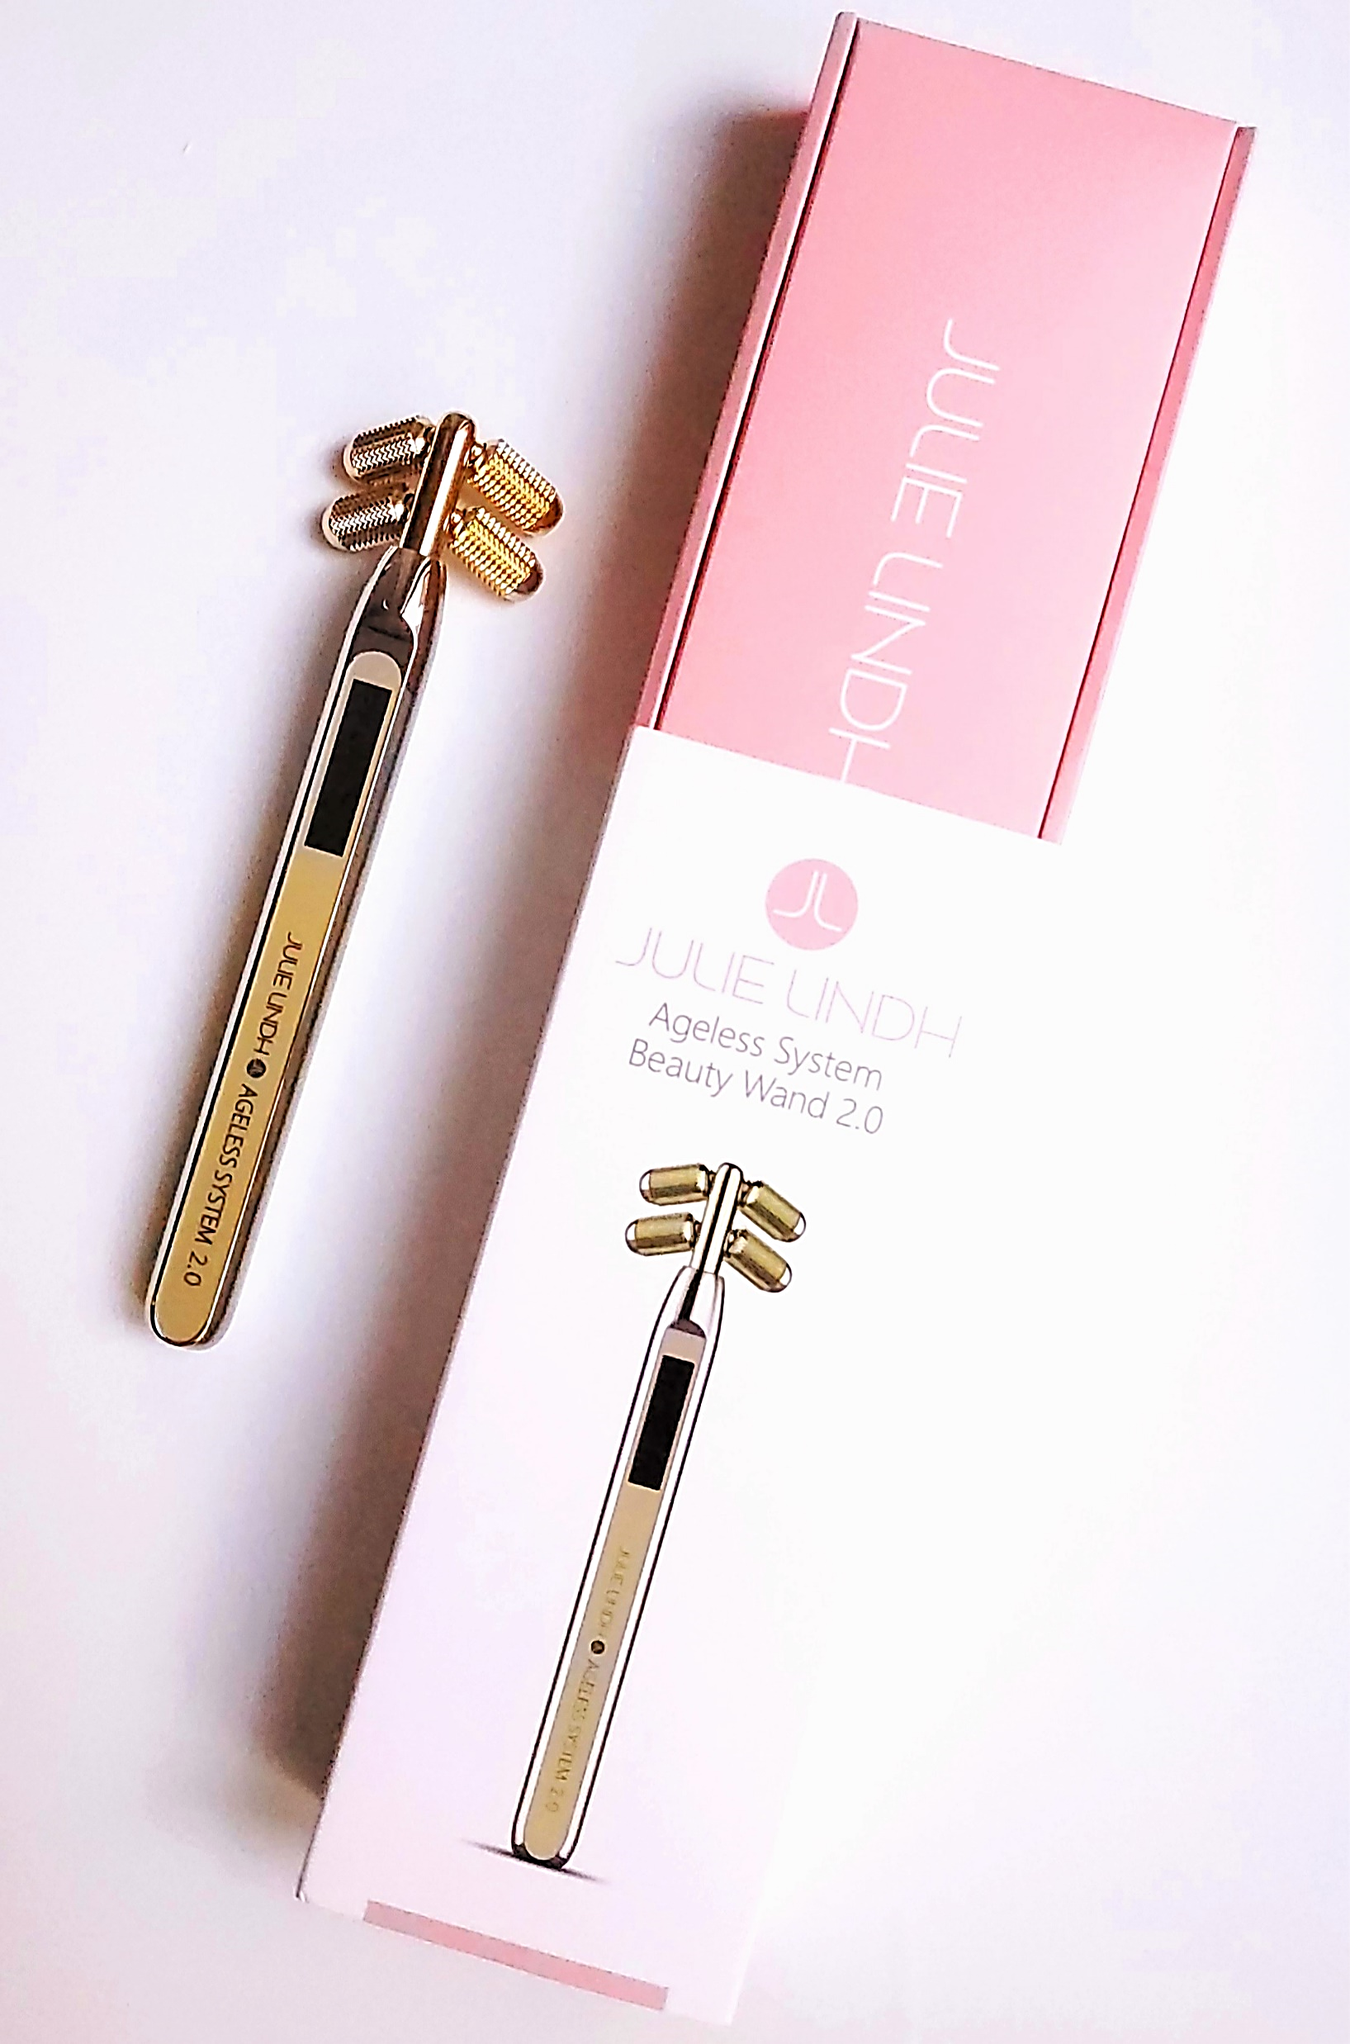
AGELESS BEAUTY WAND 2.0
Sustainable Beauty
What does it do?
3-in-1
The friction from the rollers gives the skin a superficial exfoliation, increases blood flow, and oxygen circulation, giving the skin a radiant glow naturally.
The spikes trigger the production of collagen and maintain younger-looking skin.
The micro-current feature helps to firm-up muscle tone and contour the face.
What does the spikes do?
The spikes on the rollers work similar to a derma roller/micro-needling, but without needles or puncturing the skin. The spikes, when gently rolled over the skin, stimulates fibroblasts and increases collagen production, which helps to heal and rejuvenate the skin.
Don’t worry – the spikes do not hurt!
The benefits of 2.0:
Triggers collagen production
Reduces the appearance of fine lines, wrinkles, acne, scarring, and stretch marks
Improves circulation
Helps with lymphatic drainage
Reduces puffiness
Tones and tightens the muscles of the face (think lifted jowls and eyebrows)
Shapes and contours the face by improving muscle tone (think contoured jawline)
Keeps skin looking youthful

Slide 7
AGELESS BEAUTY WAND FAQS
How does the Beauty Wand feel on the skin?
You will not feel any tingling, cutting, burning, electric shocks, zaps, or pain - you will only feel the rollers and the spikes on the skin. The wand produces a micro-current that interacts with the muscle beneath the skin, but you won't feel it. When you begin to roll the wand around your face, you may feel slight friction and warm due to increased blood circulation and oxygen.
Do I need to use special products or gels with the Beauty Wand?
You can use the Beauty Wand on dry skin to get the massaging benefits, but Julie highly recommends using it with products. You don't need special conducting gels or products to use with the wand, but in order for the micro-current to flow, you will need moisture (try using a non-oily moisturizer, Aloe Vera gel or Hyaluronic serum) to act as a conductor between the four rollers and your skin. The moisture will help to transmit the bio-electricity from the wand to stimulate the muscle fibers beneath the skin.
How do I turn the Beauty Wand on?
There is no ON/OFF button on the Beauty Wand, and there is no light or indication that the wand is on. All you have to do is to expose the solar panel to indoor light or sunlight, and the wand is ready to use. You can use the wand in the dark but the micro-current feature will not work as great without light in the room.
How do I charge the Beauty Wand?
The Beauty Wand is solar-powered. The solar panel on the handle that absorbs light and generates electricity. This panel acts as a built-in battery that gets recharged by either indoor OR outdoor light.
You can expose the solar panel under the light for 5 minutes before using and it will be fully charged for a couple of hours.

Slide 8
AGELESS BEAUTY WAND FAQS
When will I start to see results?
You will start seeing results within 2 weeks using the wand. Julie highly encourages using the wand as part of your skincare routine every day or three times a week. Your skin will first start to look fresh and glowing. Over time, you will start to look firmer, toned, and contoured too.
How many times should I roll the Beauty Wand?
Julie recommends at least 15 passes for each part. You can use the wand on the face, neck, and other areas on the body.
How do I clean the Beauty Wand?
The Beauty Wand is very easy to clean because the rollers are made out of iron, brass, refined copper and 14-carat plated gold. Simply use the mini brush to clean the roller and disinfectant wipes after each use. Other than cleaning the wand, there is no other special maintenance.
When do I need to replace the wand?
With proper care, the Beauty Wand will work for years. The only time you will have to replace your Beauty Wand is if the solar panel breaks.
Can I use the Beauty Wand everywhere? Are there any areas to avoid?
You can use the Beauty Wand everywhere except for on the eyelids and on the eyeballs. You should also avoid the thyroid area, which is in the middle of the chest plate. Not suitable for rosacea or highly sensitive skin, active acne or open wounds.
Julie's Tip
I highly recommend using the wand 1.0 in the morning because it helps with circulations, minimizes puffiness and makes your skin alive. 1 minute without product and 5 minutes with products.
Use the wand 2.0 in the evening before bed. You wake up looking rested and glowing as if your skin went through a detox and repaired itself.
Do use the wand with a sheet mask for extra stimulation.

Slide 9
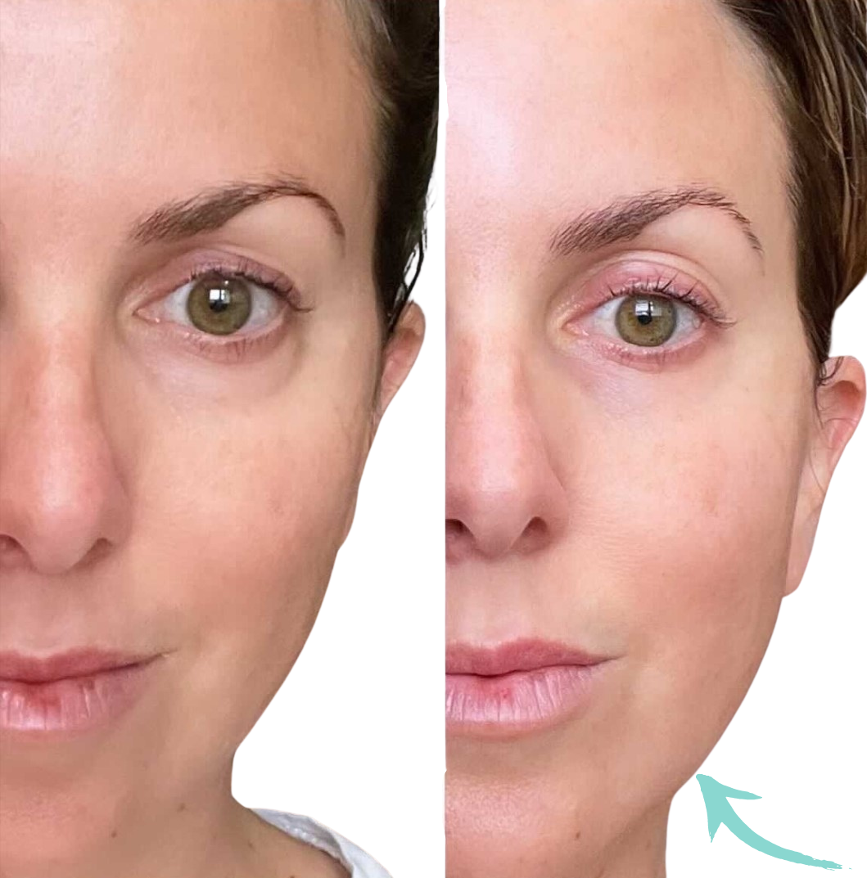
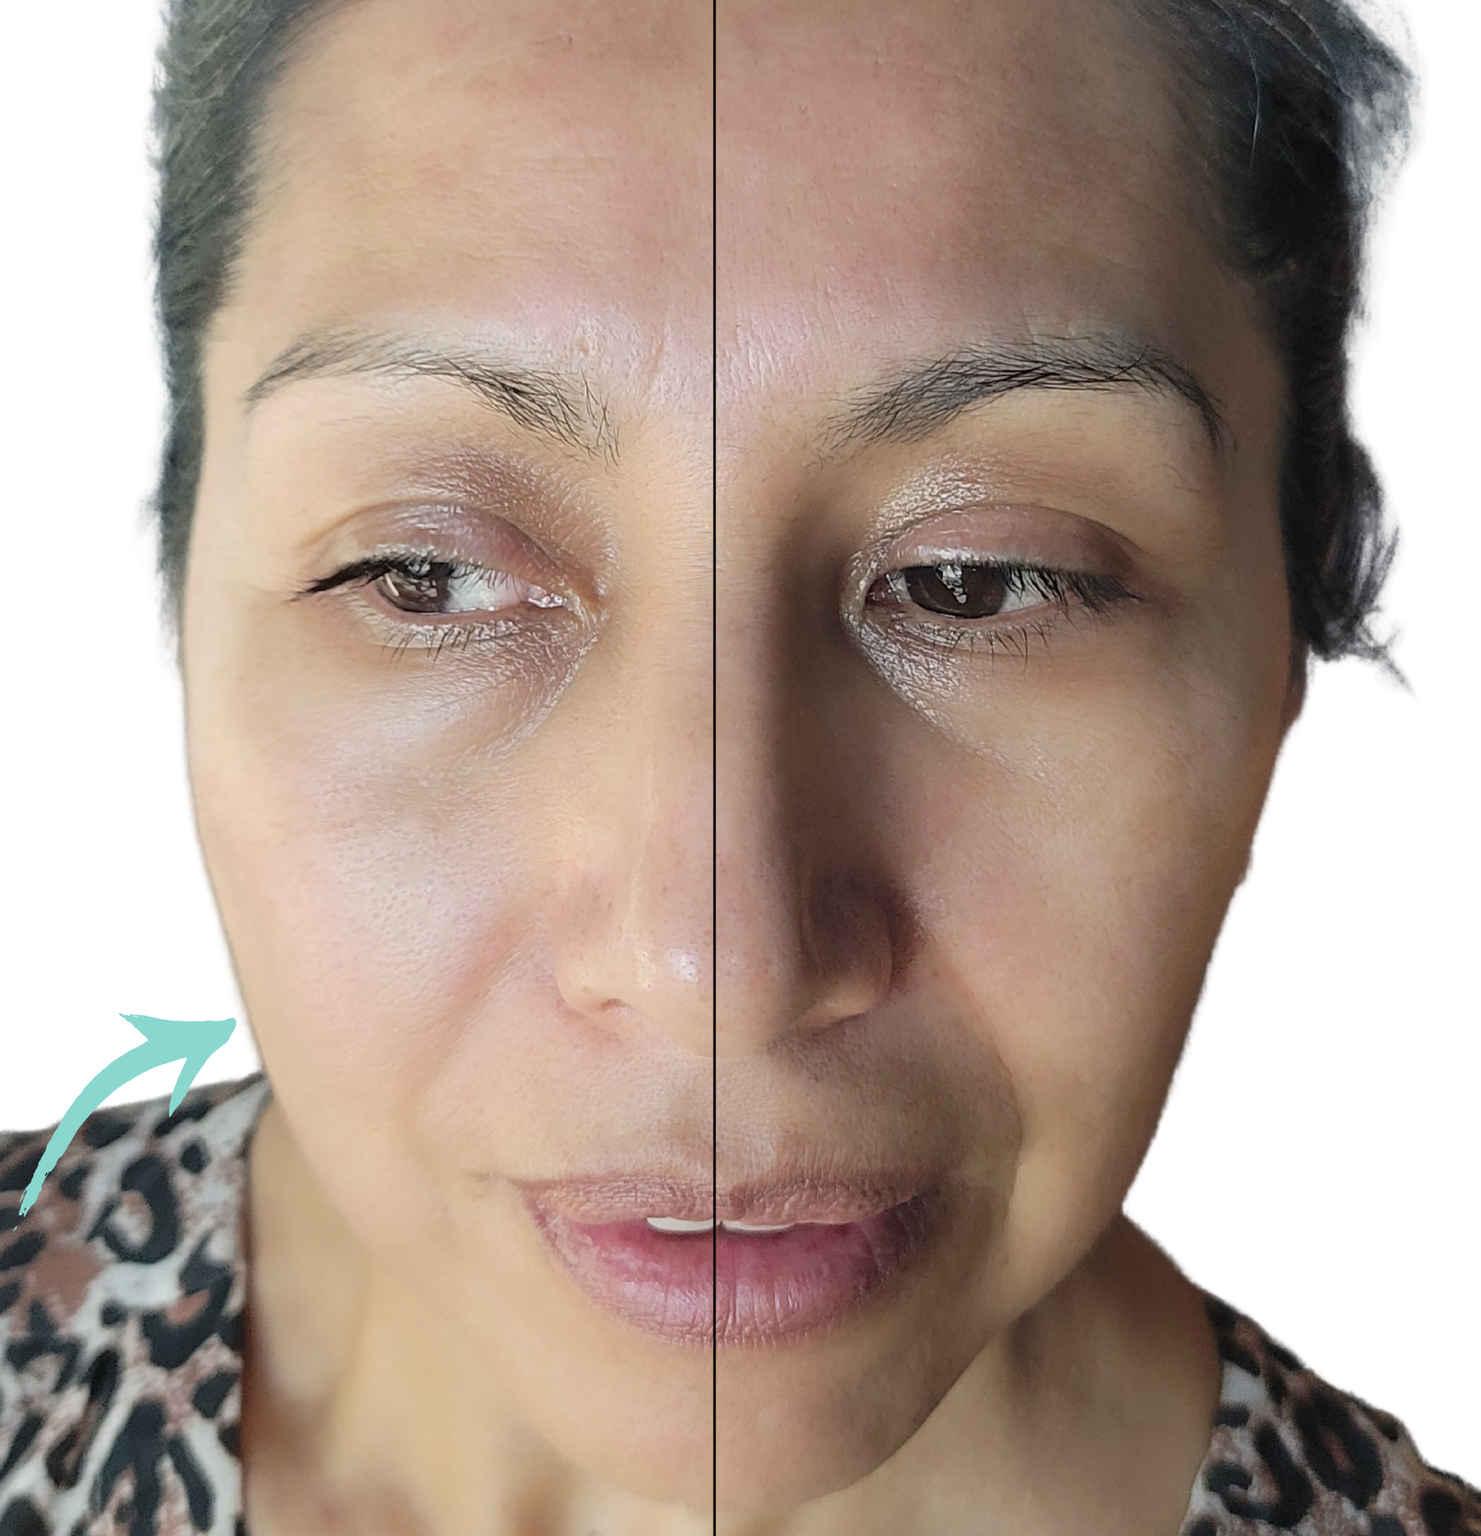
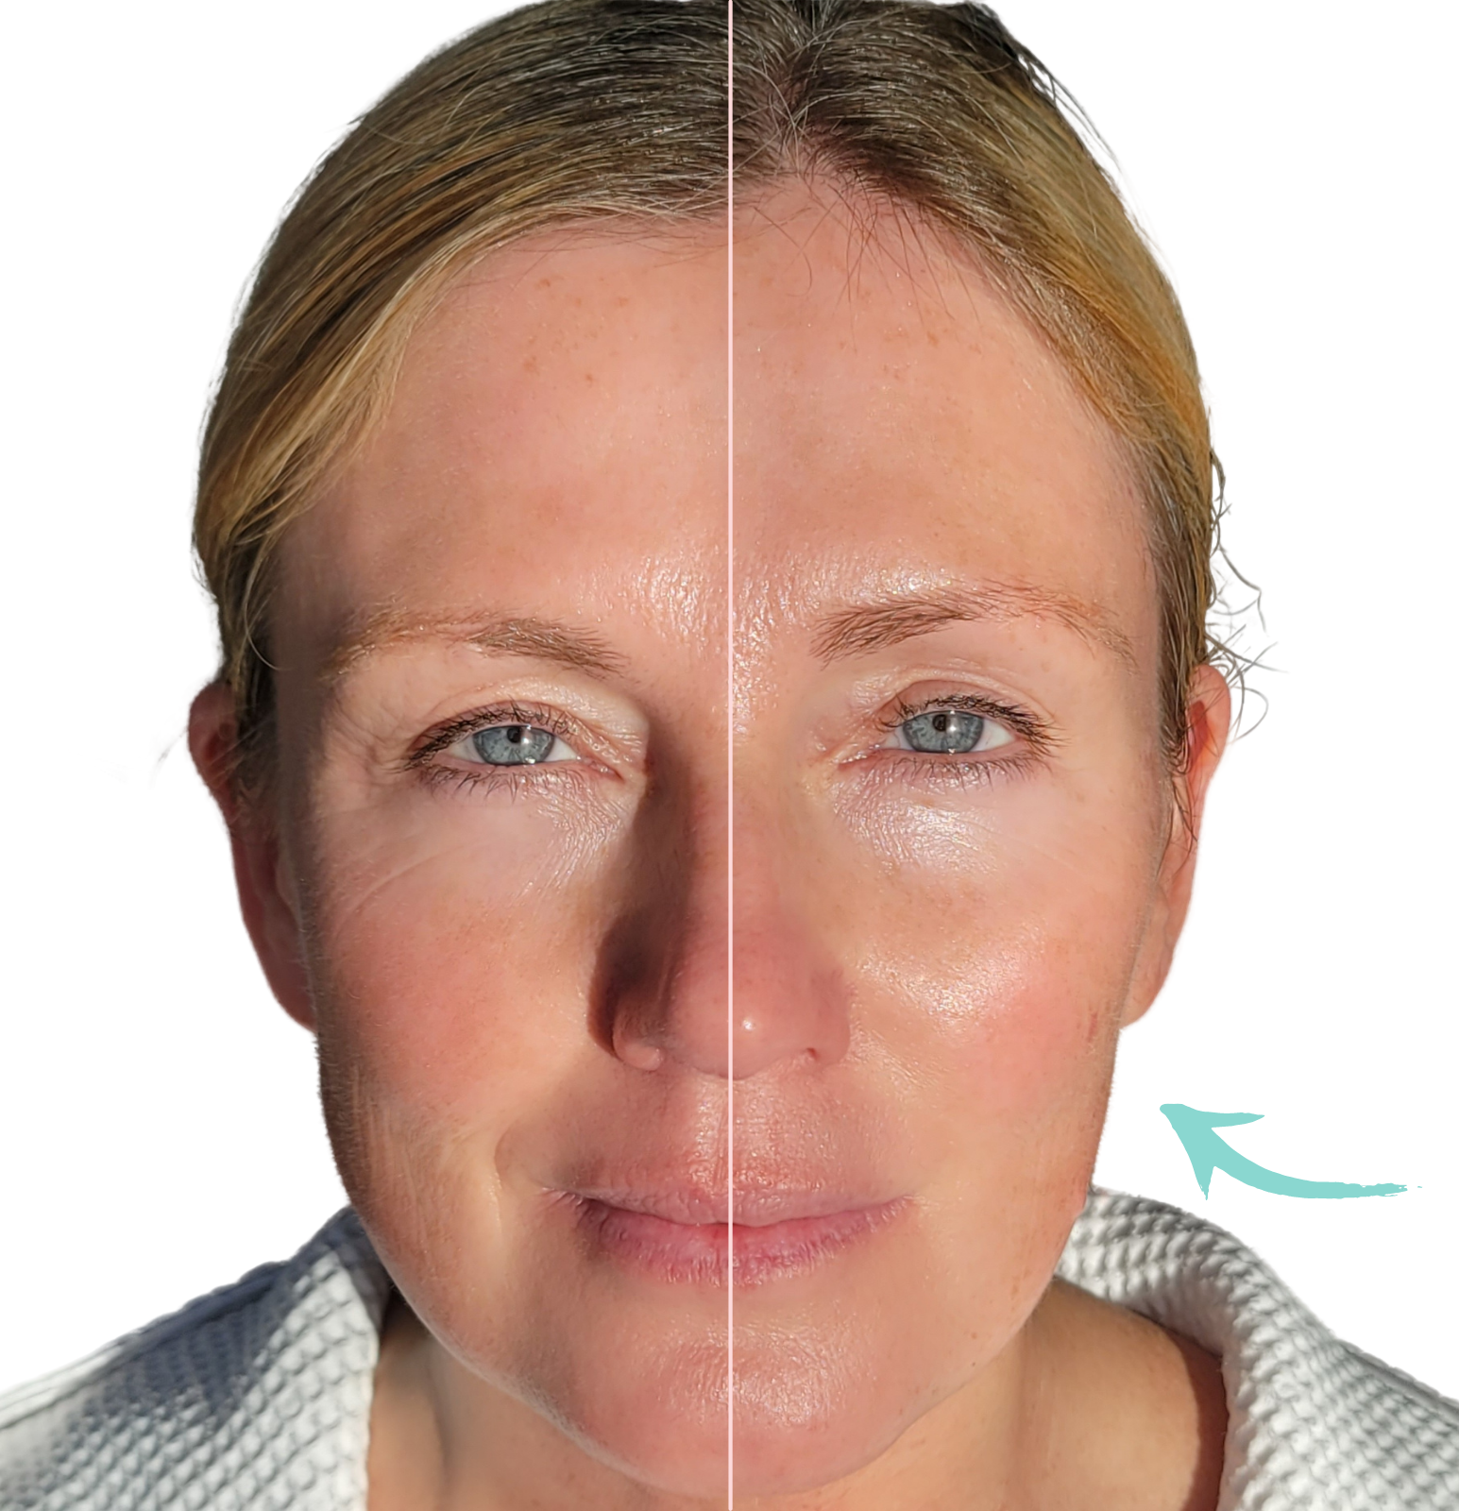
BEFORE & AFTER

Slide 10
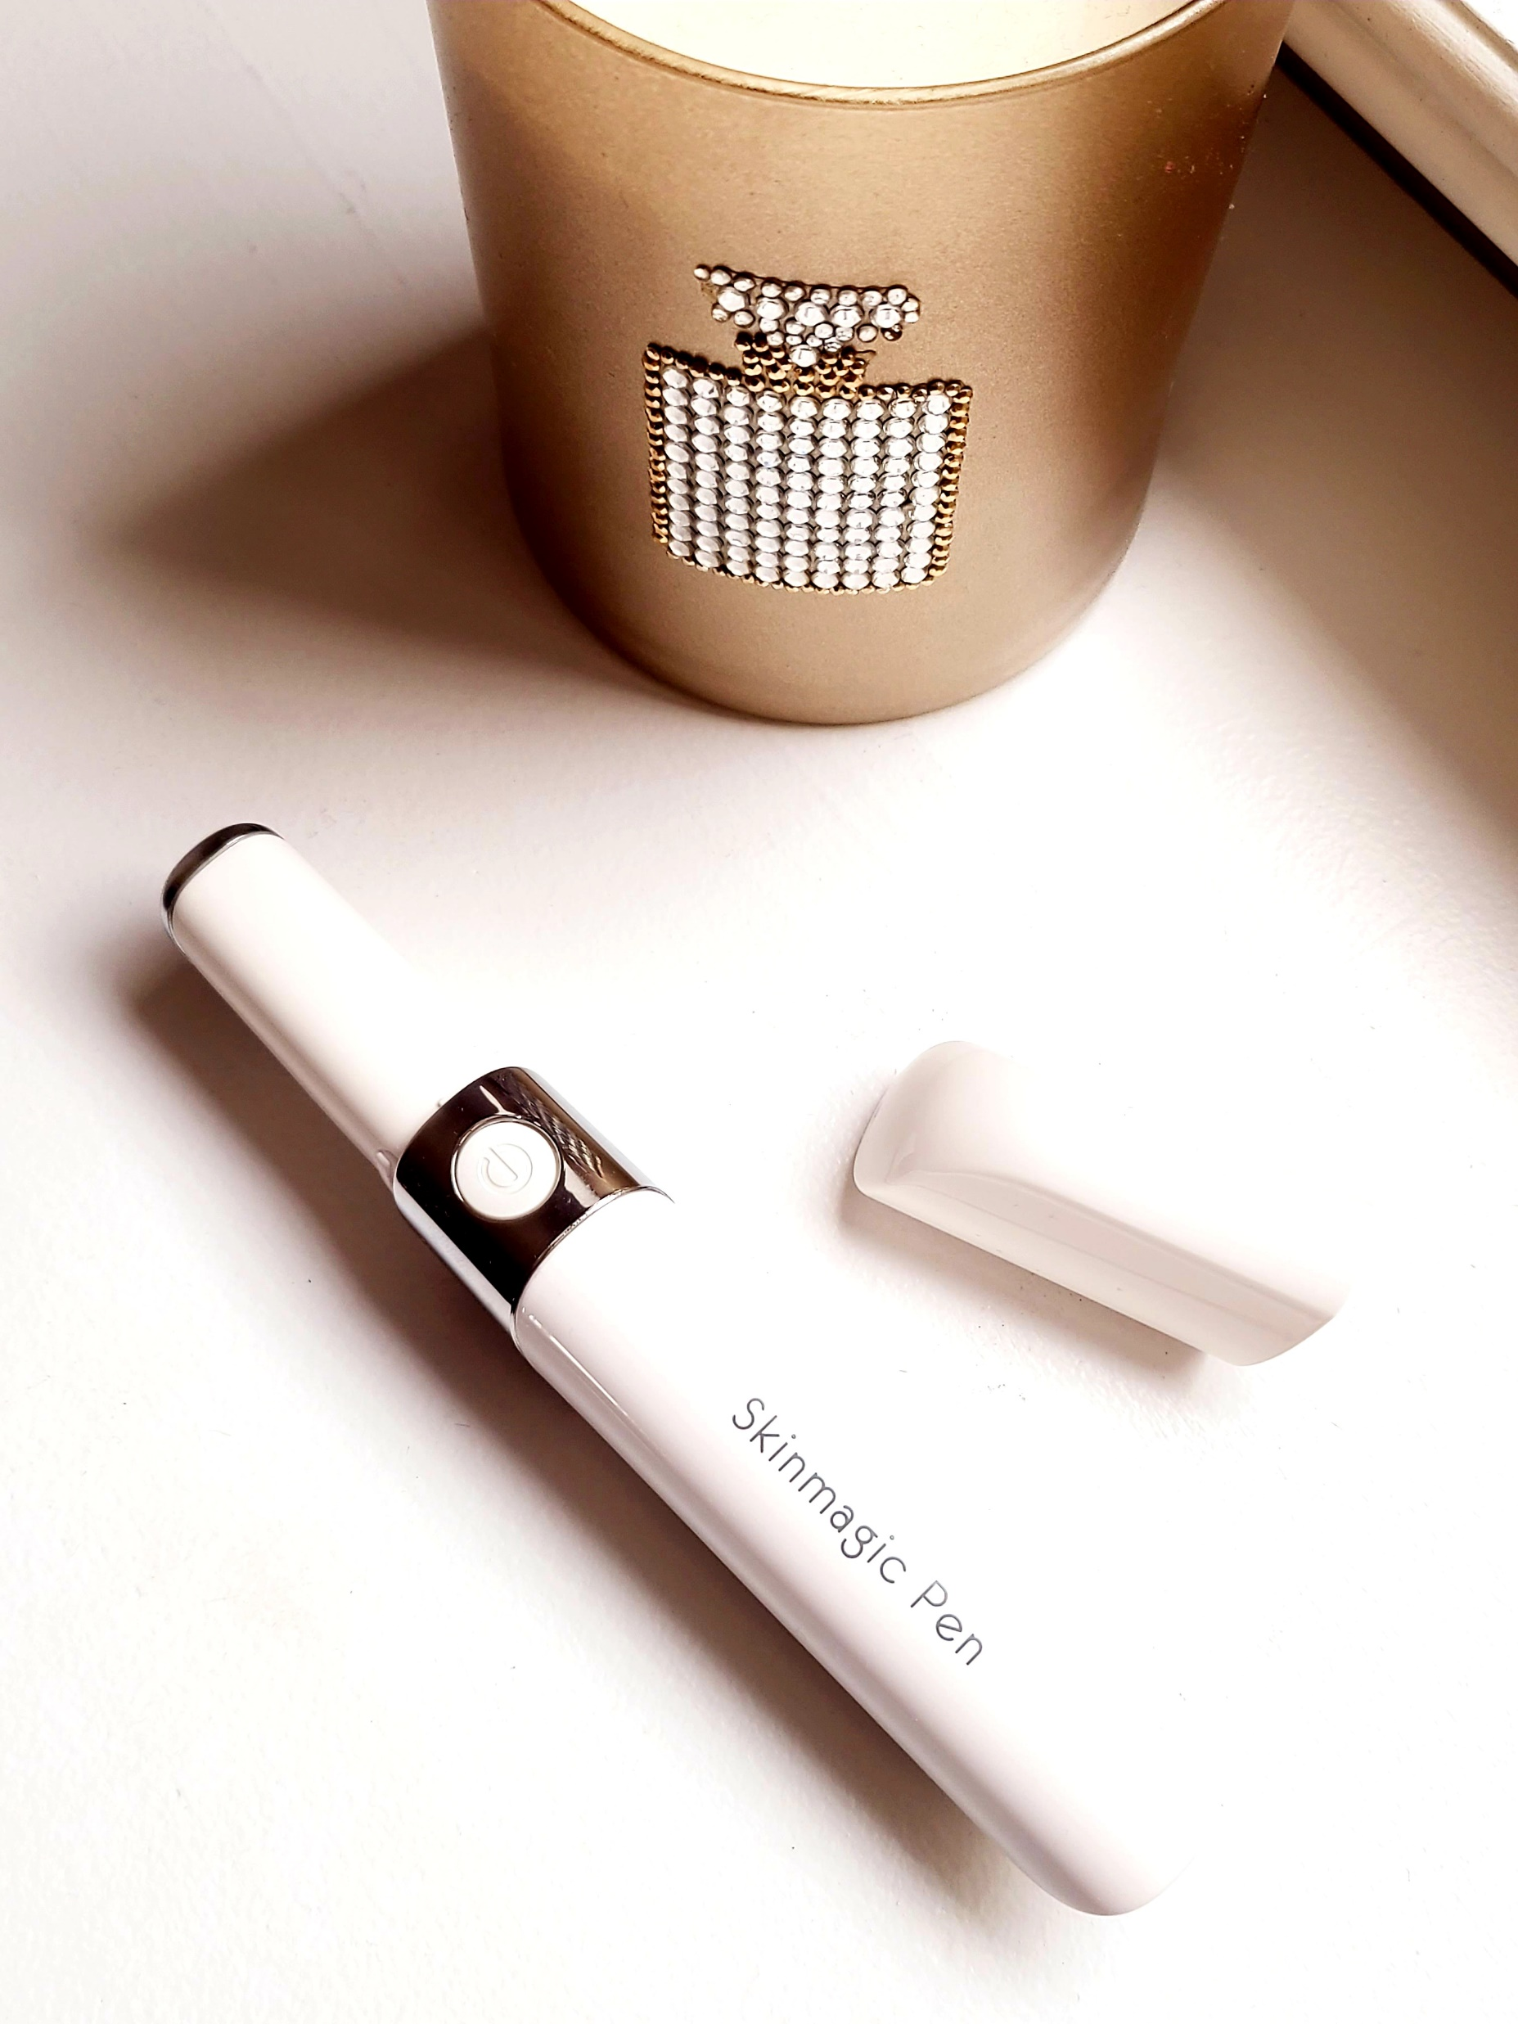
SKINMAGIC PEN
Features
Nourishment Mode:
Red LED light
Helps skincare products absorb deeper into the skin
Rejuvenates skin around the eyes and lips
Improves the appearance of under-eye bags, circles, wrinkles, and puffiness
Promotes healing and stimulates collagen
Reduces the appearance of fine lines and wrinkles
Massage Mode:
Blue LED light
Massages and relaxes the skin and muscles
Promotes a sense of calm and reduces fatigue
Relieves stress
Reduces acne
Aids in lymphatic drainage
Acupoint massager
Sustainable Beauty
What does it do?
The SKINMAGIC Pen is a high-tech, multi-use device designed to improve the appearance of skin around the eyes and lips by using sonic vibrations and LED lights. The thermal energy and massaging functions of the SKINMAGIC Pen work together to fade under eye circles, tighten bags, reduce puffiness, and improve the appearance of fine lines and wrinkles.

Slide 11
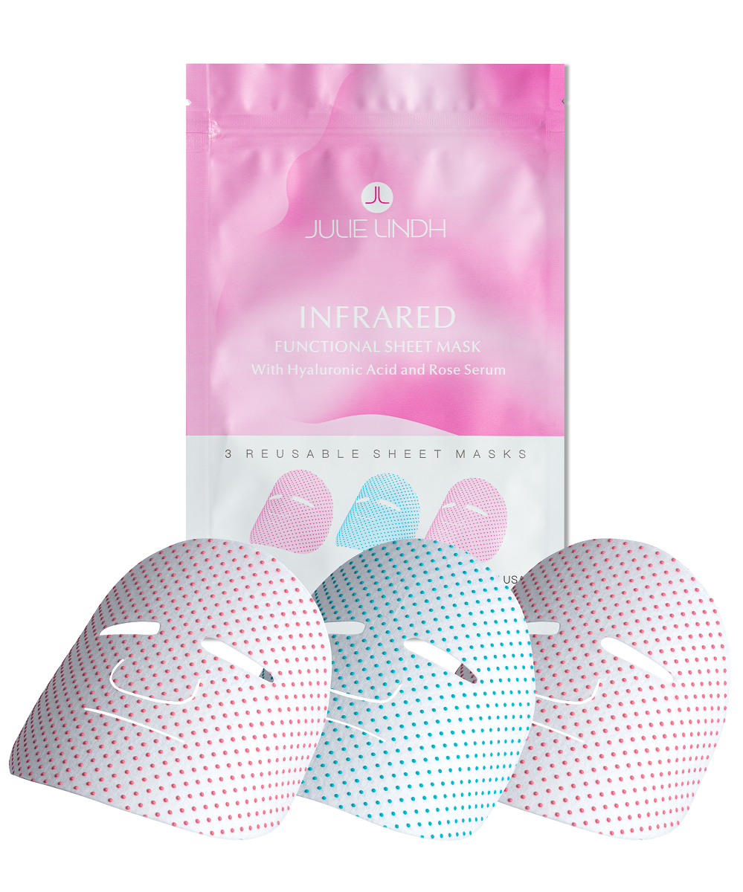
SHEET MASKS
Benefits
Helps to reduce signs of aging
Tightens skin
Lightens dark spots
Improves circulation
Encourages lymphatic drainage
You can reuse this mask for up to five treatments. After the first use, rinse the sheet mask with water and hang dry. To reuse, wet the mask with face toner or cool water and apply as direction specify.
Ingredients: Sheet mask: Nanoscale tourmaline, organometallic germanium on non-woven fabric Serum Ingredients: Hyaluronic Acid (Sodium Hyaluronate), Organic Aloe Leaf Juice (Aloe Barbadensis), Rose Flower Water (Rosa Damascena), Glycerin, Phenoxyethanol, Tetrasodium Glutamate Diacetate.
Innovative Skin Care Solution
Infrared Functional Sheet Mask with Hyaluronic Acid & Rose Serum | 3 Reusable Masks
A sheet mask that looks like it’s from the future and makes your skin look years younger. Julie Lindh’s Infrared Sheet Masks use organic elements that emit infrared rays to reduce signs of aging, such as dark spots and wrinkles, and improves lymphatic drainage and circulation.
These revolutionary sheet masks use an intelligent temperature-sensing system that contains the mineral tourmaline and the element germanium – together they give off an infrared ray that’s absorbed by your skin’s cells. Your skin will look brighter, fresher and rejuvenated after just one use!

Slide 12
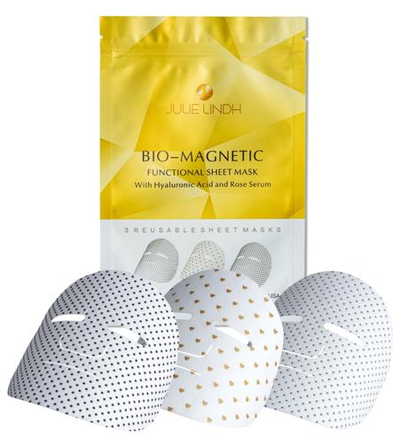
SHEET MASKS
Benefits
Smooth’s out signs of aging
Helps to reduce wrinkles and fine lines
Reduce inflammation
Eliminate puffiness
Deeply moisturize.
Magnetic stimulation also helps to detoxify
You can reuse this mask for up to five treatments. After the first use, rinse the sheet mask with water and hang dry. To reuse, wet the mask with face toner or cool water and apply as direction specify
Innovative Skin Care Solution
Bio-Magnetic Sheet Mask with Hyaluronic Acid & Rose Serum
| 3 Reusable Masks
Anti-aging sheet mask that uses the force of magnets to transform your skin. Julie Lindh’s Bio-Magnetic Sheet Masks are woven with actual magnets that create an anti-aging force field around your face.
This revolutionary sheet mask uses magnets that interact with your own cellular bio-magnetism to smooth out signs of aging. Magnetic stimulation also helps to detoxify and normalize cellular activities. Rubbing the magnetic dots on the mask provides a delightful facial massage and more action on the skin. After just one use your skin will feel fresh, firmer, clearer, and glowing.
Ingredients: Sheet mask: Nanoscale Magnet on non-woven fabric. Serum Ingredients: Sodium Hyaluronate (Hyaluronic Acid), Organic Aloe Leaf Juice (Aloe Barbadensis), Rose Flower Water (Rosa Damascena), Glycerin, Phenoxyethanol, Tetrasodium Glutamate Diacetate.

Slide 13
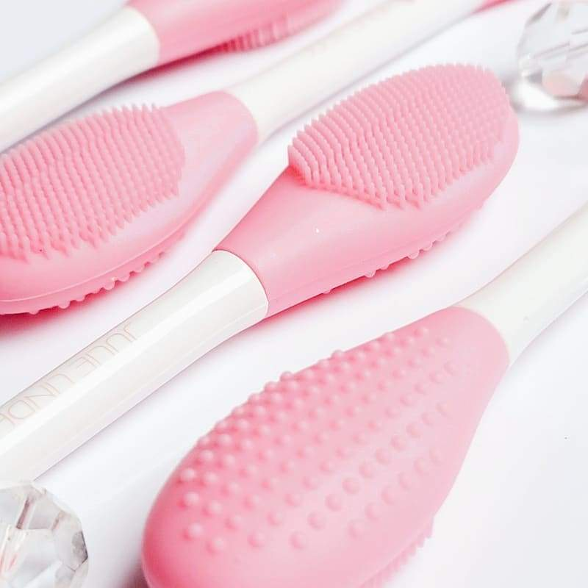
PORE CLEANSING
BRUSH AND SPATULA
Innovative Skin Care Solution
A perfect facial cleansing tool if you want clear skin. Our facial brush is 100% natural food-grade silicone. A gentle silicone pore cleansing brush to buff away buildup of oil and dirt.
The brush side helps to clean and exfoliate your skin, softens the skin to open pores and gently remove impurities and dead skin. It also promotes blood circulation. The uneven side helps with product absorption and a gentle massage to the skin. The spatula is perfect for mask applications.

Slide 14
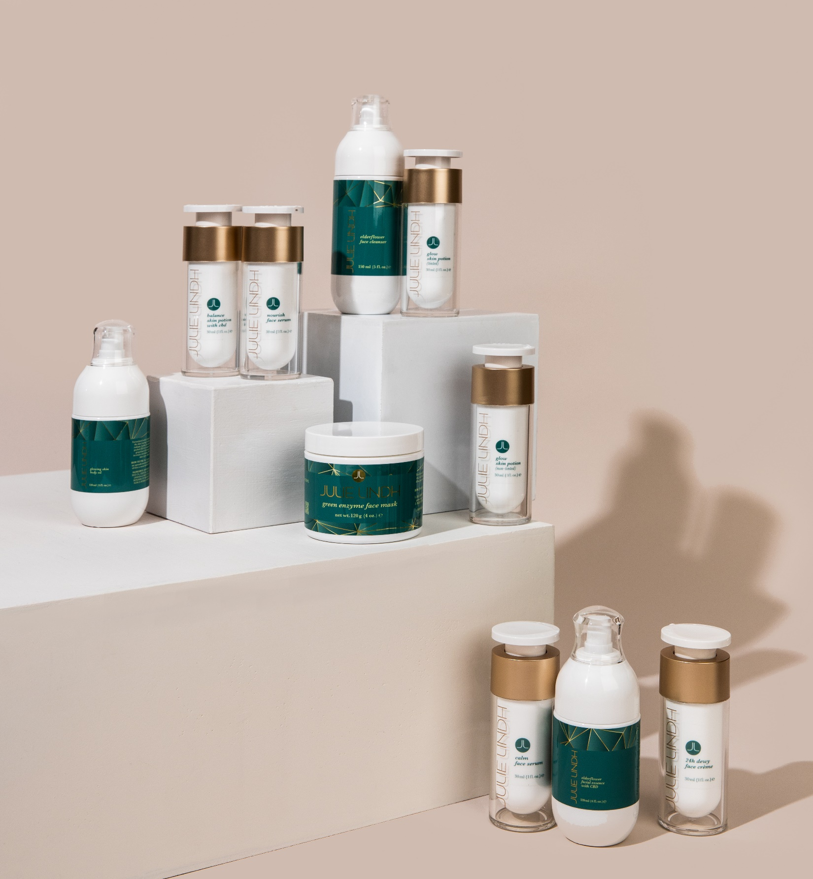
GREEN
BEAUTY
SYSTEM
Clean Beauty

Slide 15
ELDERFLOWER FACE WASH
Size: Travel size - 30ml Full size - 150ml
Elderflower and berry are mildly astringent so are helpful in refining the complexion. The astringent properties cause the skin to tighten, reducing the size and appearance of pores. The reduction of pores in the skin to a healthy size has the benefit of making the skin look and feel smoother and fresh.
Aloe Vera: Acts a great moisturizer that helps treat sunburns and acne while also fighting signs of aging.
Honeysuckle: Japanese honeysuckle has antiseptic and anti-inflammatory properties, helps reduces skin irritation that can cause redness, sensitivity, and acne-prone skin. It’s also a natural preservative.
Hyaluronic Acid: Increase skin moisture, reduce the appearance of fine lines and wrinkles, and plump skin.
“Use this cleanser with the Konjac Sponge or the Pore Cleansing brush for deeper cleaning.” ~Julie

Slide 16
ELDERFLOWER FACE WASH
Size: Travel size - 30ml Full size - 150ml
A non-drying facial wash and a toner in one What it is: A gentle daily face wash that is formulated with superfood Elderflower, antioxidant Honeysuckle, and soothing Aloe Vera to give your skin a deep cleansing and non-drying. What it does: Elderflower has an astringent benefits which makes this face wash a unique combination of a cleanser and a toner. It foams enough that some uses it a shaving crème. Who’s it for: ✔ Normal skin ✔ Oily skin ✔ Combination skin ✔ Sensitive skin How to use: Wet face with warm water. Lather a small amount in your hands and massage onto your face using a circular motion, avoiding the eye area. Rinse thoroughly with warm water. You may have to wash your face twice if you’re wearing heavier make-up.. Ingredients: Aloe Barbadensis (Organic Aloe Leaf) Juice, Lauryl Glucoside, Sodium Cocoamphoacetate, Decyl Glucoside, Sambucus nigra SSP (Elderflower) Distillate, Kosher Vegetable Glycerin, Citrus paradisi (Grapefruit) essential oil, Lonicera caprifolium (Honeysuckle) flower extract, Lonicera japonica (Honeysuckle) flower extract, Hydrolyzed Quinoa Protein, Tetrasodium Glutamate Diacetate, Sodium Hyaluronate (Hyaluronic Acid), DL-Panthenol (Provitamin B5), and Citrus aurantium (Neroli) flower essential oil.
Caution: Discontinue use if irritation occurs or if you are allergic to the ingredients listed. For external use only.

Slide 17
ELDERFLOWER FACIAL ESSENCE
Size: Travel size - 30ml Full size - 120ml
Elderflower and berry are mildly astringent so are helpful in refining the complexion. The astringent properties cause the skin to tighten, reducing the size and appearance of pores. The reduction of pores in the skin to a healthy size has the benefit of making the skin look and feel smoother and fresh.
Aloe Vera: Acts a great moisturizer that helps treat sunburns and acne while also fighting signs of aging.
Rosehip: Rich in vitamins E and C and essential fatty acids, which helps to boost collagen production to minimize wrinkles and fine lines.
Honeysuckle: Japanese honeysuckle has antiseptic and anti-inflammatory properties, helps reduces skin irritation that can cause redness, sensitivity, and acne-prone skin. It’s also a natural preservative.
Hyaluronic Acid: Increase skin moisture, reduce the appearance of fine lines and wrinkles, and plump skin.
Hemp Seed Oil: Anti-inflammatory properties and antioxidants to boost cell health and repair damaged skin.
“This milky facial essence is perfect for all skin types. If you have oily/acne skin you can use this essence alone as it hydrates without leaving a film on the skin. It is also great for after shaving, itchy scalp, skin rash and sunburn. I love mixing it with the Green Enzyme Mask powder. The natural citrus aroma makes you want to take a bath in it. You will love what it can do for your skin.” ~Julie
Powerful Ingredients

Slide 18
ELDERFLOWER FACIAL ESSENCE with CBD
Size: Travel size - 30ml Full size - 120ml
A luxurious elixir for the skin. What it is: The Elderflower Facial Essence is lightweight and easily absorbed into the skin. Packed with superfood and antioxidant formulas to soothe skin irritation, hydrates superficial dehydrated skin, and combat the signs of aging. What it does: The low molecular structure of this essence helps to bring all the ingredients deep down into the skin to strengthen and rejuvenate the cells. The ingredients also include 150mg of CBD Seed Extracts for anti-inflammatory and anti-aging benefits. Who’s it for: ✔ Normal skin ✔ Oily skin ✔ Combination skin ✔ Sensitive skin How to use: After cleansing, shake and pour 1-2 pump of the essence into hand, then gently pat over face and neck. Follow with a serum and creme. Ingredients: Aloe Barbadensis (Organic Aloe Leaf) Juice, Sambucus nigra SSP (Elderflower) Distillate, Sodium sunflowerseedate, Kosher Vegetable Glycerin, Rosa canina (refined Rosehip) Seed Oil, Lonicera Caprifolium (Honeysuckle) flower extract, Lonicera Japonica (Honeysuckle) flower extract, Organic Grape Alcohol (and) Sambucus nigra (Elderberry) Extract, Tetrasodium Glutamate Diacetate, Sodium Hyalurate (Hyaluronic Acid), Hemp Seed Oil, Dimethylaminoethanol Bitartrate (DMAE), Essential oils of Citrus paradisi (Grapefruit) and Citrus aurantium (Neroli) flower.
Caution: Discontinue use if irritation occurs or if you are allergic to the ingredients listed. For external use only.

Slide 19
GREEN ENZYME FACE MASK
Size: Full size - 100ml – 15 trt
Oatmeal: Absorbs excessive oil from the skin, and helps to fight acne. It also helps to prevent and protect dry skin.
Wheatgrass: Restores your body’s pH by lowering acidity levels. Improves cell strength due to its detoxifying and cleansing properties.
Barley Grass: Rich in amino acids, vitamins, antioxidants and minerals that your skin needs to keep outside pollutants at bay, delays the signs of aging and evens out skin tone.
Peppermint: Helps to control acne and makes your skin brighter.
Rosehip: Rich in vitamins E and C and essential fatty acids, which helps to boost collagen production to minimize wrinkles and fine lines.
Green Tea: A powerful antioxidant with anti-inflammatory properties.
Papain: A remarkable fruit extract from papaya that works to reduce the appearance of scars.
Bromelain: Reduces inflammation and provides relief to itchy skin.
Calendula Petal: Has amazing anti-inflammatory properties, also acts as a fantastic remedy for acne and stubborn wounds.
Baking Soda: Works as an exfoliator that absorbs excessive amounts of oil and keeps pores open. Also works as a toner and natural astringent that can help you eliminate the top layer of dead skin cells.
Alfalfa: Works as a natural cleanser and prevents excessive dryness. It is rich in minerals (calcium, iron, and zinc) and vitamins (C and B).
Aloe Vera: Acts a great moisturizer that helps treat sunburns and acne while also fighting signs of aging.
Spinach: Packed with vitamins A, C, E and K. Provides a broad spectrum of benefits including sun protection, acne treatment, skin repair and acts as a shield against premature aging.
13 Powerful Ingredients
‘Its like juicing on the outside”
~Julie

Slide 20
GREEN ENZYME FACE MASK
Size: Full size - 100ml – 15 trt
Infused with 13 different antioxidant-rich and superfood ingredients, this mask helps revitalize and restore a smooth, even texture as the fresh, herbaceous aroma transports you to another world. What it is: The Green Enzyme Mask is pampering green face mask full of all-natural ingredients that will make your complexion look radiant while also restoring firmness to your skin. After just one use, your skin will feel relaxed and renewed. This mask comes in a powder that is activated by water, toner or moisturizer. What it does: This mask does it all! It gently exfoliates away dead skin cells, excess sebum and other impurities to reveal more radiant skin. It also contains several plant-based ingredients that help to hydrate, calm and soothe the skin. This mask also helps to control blackheads by stimulating circulation, which helps to detoxify the skin. After just one use of this mask, your skin will look renewed and have a youthful glow. Who’s it for: ✔ Normal skin ✔ Oily skin ✔ Combination skin ✔ Sensitive skin How to use: The Green Enzyme Face Mask can be used three different ways: Oily/Combination skin: Activate with water and use it as a scrub with gentle circular motions. Rinse off with cool water.
Dry skin: Blend with your favorite face crème or moisturizer and apply to face. Cover with a damp paper towel and let sit for 15 minutes. Rinse off with cool water.
All skin types: Apply as a treatment mask by mixing with hot water to form a paste. Once the paste cools, apply a thick layer on face and let sit for 10 minutes. Rinse with cool water.
Ingredients: Oatmeal, Wheatgrass, Barley Grass, Peppermint Leaf, Rosehip, Green Tea Extract, Papain, Bromelain, Calendula Petal Extract, Baking Soda, Alfalfa Leaf, Aloe Vera Leaf Extract and Spinach.

Slide 21
GLOW SKIN POTION – NON-TINTED
Size: Travel size - 5ml Full size - 30ml
Rose Hip Seed Oil
Rich in Vitamin A and essential fatty acids. Two vital components of Rosehip Seed Oil are Linoleic and Linolenic Acids, which play an important role in nourishing the skin.
15 Powerful Essential Oils of Flowers and Plants
Together they help to regenerate energy in the skin tissue to repair free radical damages such as sun-damaged skin, premature aging, uneven skin tone and lack of elasticity.
‘If your skin starts to look tired midday, this is your secret to looking fresh and glowing all day long. Never leave your house without it!’
~Julie
‘The tinted version does give skin the sun-kissed glow all year round. It is also a great finishing treatment product as it gives beautiful color that adapts to skin tone.
Made with 15 flower and plant oils
Deeply moisturizing, nourishing and soothing
Heals, repairs, hydrates and rejuvenates
Comes in tinted (for a sun-kissed glow) and non-tinted

Slide 22
GLOW SKIN POTION – NON-TINTED
Size: Travel size - 5ml Full size - 30ml
A delightful oil that some have called a magic potion. Just this one product hydrates, rejuvenates, heals and repairs the skin in a single step. Skin Potion Nourishing Face Oil comes in tinted (for a sun-kissed glow) and non-tinted. What it is: This is the all-time bestselling Miss Julie product that has grown a cult-like following. And it’s easy to see why - the Skin Potion Face Oil, is deluxe, deluxe, deluxe! It sinks into the skin instantly and starts to work immediately. It’s so hydrating that you can use it instead of a moisturizer or turbo-charge your moisturizer by applying this oil first. What it does: This face oil was specifically designed to heal, repair, rejuvenate and hydrate with the best all-natural ingredients available. Made with 15 flower and plant oils like neroli (full of vitamin C for glow), rosehip seed oil (rich in vitamin A & essential fatty acids), jojoba oil (moisturizes and restores healthy, smooth, and glowing skin) and many more, this oil will give you super soft, super supple and gorgeous glowing skin. With all those delicious natural ingredients, it leaves a barely-there, but nonetheless gorgeous scent. Who’s it for: ✔ Normal skin ✔ Oily skin ✔ Combination skin ✔ Sensitive skin How to use: After cleansing, rub a few drops of the potion all over the face and neck. Julie’s tip: If your skin starts to look tired midday, this is your secret to looking fresh and glowing all day long. Never leave your house without it! Ingredients: Rosa canina (refined Rosehip) Seed Oil, Simmondsia chinensis (Jojoba) seed Oil, Vanilla planifolia fruit extract, essential oil of Citrus paradisi (Grapefruit), Citrus aurantium (Neroli) flower, Jasminum officinale var. grandiflorum (Jasmine Absolute), Pelargonium graveolens (Geranium), Anthemis nobilis (Roman Chamomile), Matricaria chamomilla (German Chamomile), Foeniculum vulgare (Sweet Fennel), Daucus carota (Carrot) seed, Citrus bergamia (FCF Bergamot), Lavandula angustifolia (Lavender), Boswellia carterii Birdwood (Frankincense), and Rosa damascene (Rose) absolute.
Caution: Discontinue use if irritation occurs or if you are allergic to the ingredients listed. For external use only.

Slide 23
GLOW SKIN POTION – TINTED
Size: Travel size - 5ml Full size - 30ml
Rose Hip Seed Oil
Rich in Vitamin A and essential fatty acids. Two vital components of Rosehip Seed Oil are Linoleic and Linolenic Acids, which play an important role in nourishing the skin.
Sea Buckthorn Berry Oil
High in antioxidant properties, this ingredient alone can defeat the signs of aging. Natural skin protection from UV rays and repair skin barrier. Strengthen skin tissues and restore elasticity.
17 Powerful Oils of Flowers and Plants
Together, they help regenerate energy in the skin tissue to repair free radical damages such as sun-damaged skin, premature aging, uneven skin tone, and lack of elasticity.
‘The tinted version does give skin the sun-kissed glow all year round. It is also a great finishing treatment product as it gives a beautiful color that adapts to skin tone.
~Julie
A delightful oil that some have called a magic potion. Just this one product hydrates, rejuvenates, heals and repairs the skin in a single step. The GLOW Skin Potion comes in tinted (for a sun-kissed glow) and non-tinted.
Pure sources of plants, flowers and seeds
Deeply moisturizing, nourishing and soothing
Heals, repairs, hydrates and rejuvenates
Comes in tinted (for a sun-kissed glow) and non-tinted

Slide 24
GLOW SKIN POTION – TINTED
Size: Travel size - 5ml Full size - 30ml
A delightful oil that some have called a magic potion. Just this one product hydrates, rejuvenates, heals and repairs the skin in a single step. Skin Potion Nourishing Face Oil comes in tinted (for a sun-kissed glow) and non-tinted. What it is: This is the all-time bestselling Miss Julie product that has grown a cult-like following. And it’s easy to see why - the Skin Potion Face Oil, is deluxe, deluxe, deluxe! It sinks into the skin instantly and starts to work immediately. It’s so hydrating that you can use it instead of a moisturizer or turbo-charge your moisturizer by applying this oil first. What it does: This face oil was specifically designed to heal, repair, rejuvenate and hydrate with the best all-natural ingredients available. Made with 15 flower and plant oils like neroli (full of vitamin C for glow), rosehip seed oil (rich in vitamin A & essential fatty acids), jojoba oil (moisturizes and restores healthy, smooth, and glowing skin) and many more, this oil will give you super soft, super supple and gorgeous glowing skin. With all those delicious natural ingredients, it leaves a barely-there, but nonetheless gorgeous scent. Who’s it for: ✔ Normal skin ✔ Oily skin ✔ Combination skin ✔ Sensitive skin How to use: After cleansing, rub a few drops of the potion all over the face and neck. Julie’s tip: If your skin starts to look tired midday, this is your secret to looking fresh and glowing all day long. Never leave your house without it! Ingredients: Rosa canina (Virgin Rosehip) Seed Oil, Simmondsia Chinensis (Jojoba) Seed Oil, Hippophae Rhamnoides (Sea Buckthorn) Berry Oil, Vanilla planifolia fruit extract, essential oil of Citrus paradisi (Grapefruit), Citrus aurantium (Neroli) flower, Jasminum officinale var. Grandiflorum (Jasmine Absolute), Pelargonium graveolens (Geranium), Anthemis nobilis (Roman Chamomile), Matricaria chamomilla (German Chamomile), Foeniculum vulgare (Sweet Fennel), Daucus carota (Carrot) Seed, Citrus bergamia (FCF Bergamot), Lavandula angustifolia (Lavender), Boswellia Carterii Birdwood (Frankincense), and Rosa damascene (Rose) absolute.
Caution: Discontinue use if irritation occurs or if you are allergic to the ingredients listed. For external use only.

Slide 25
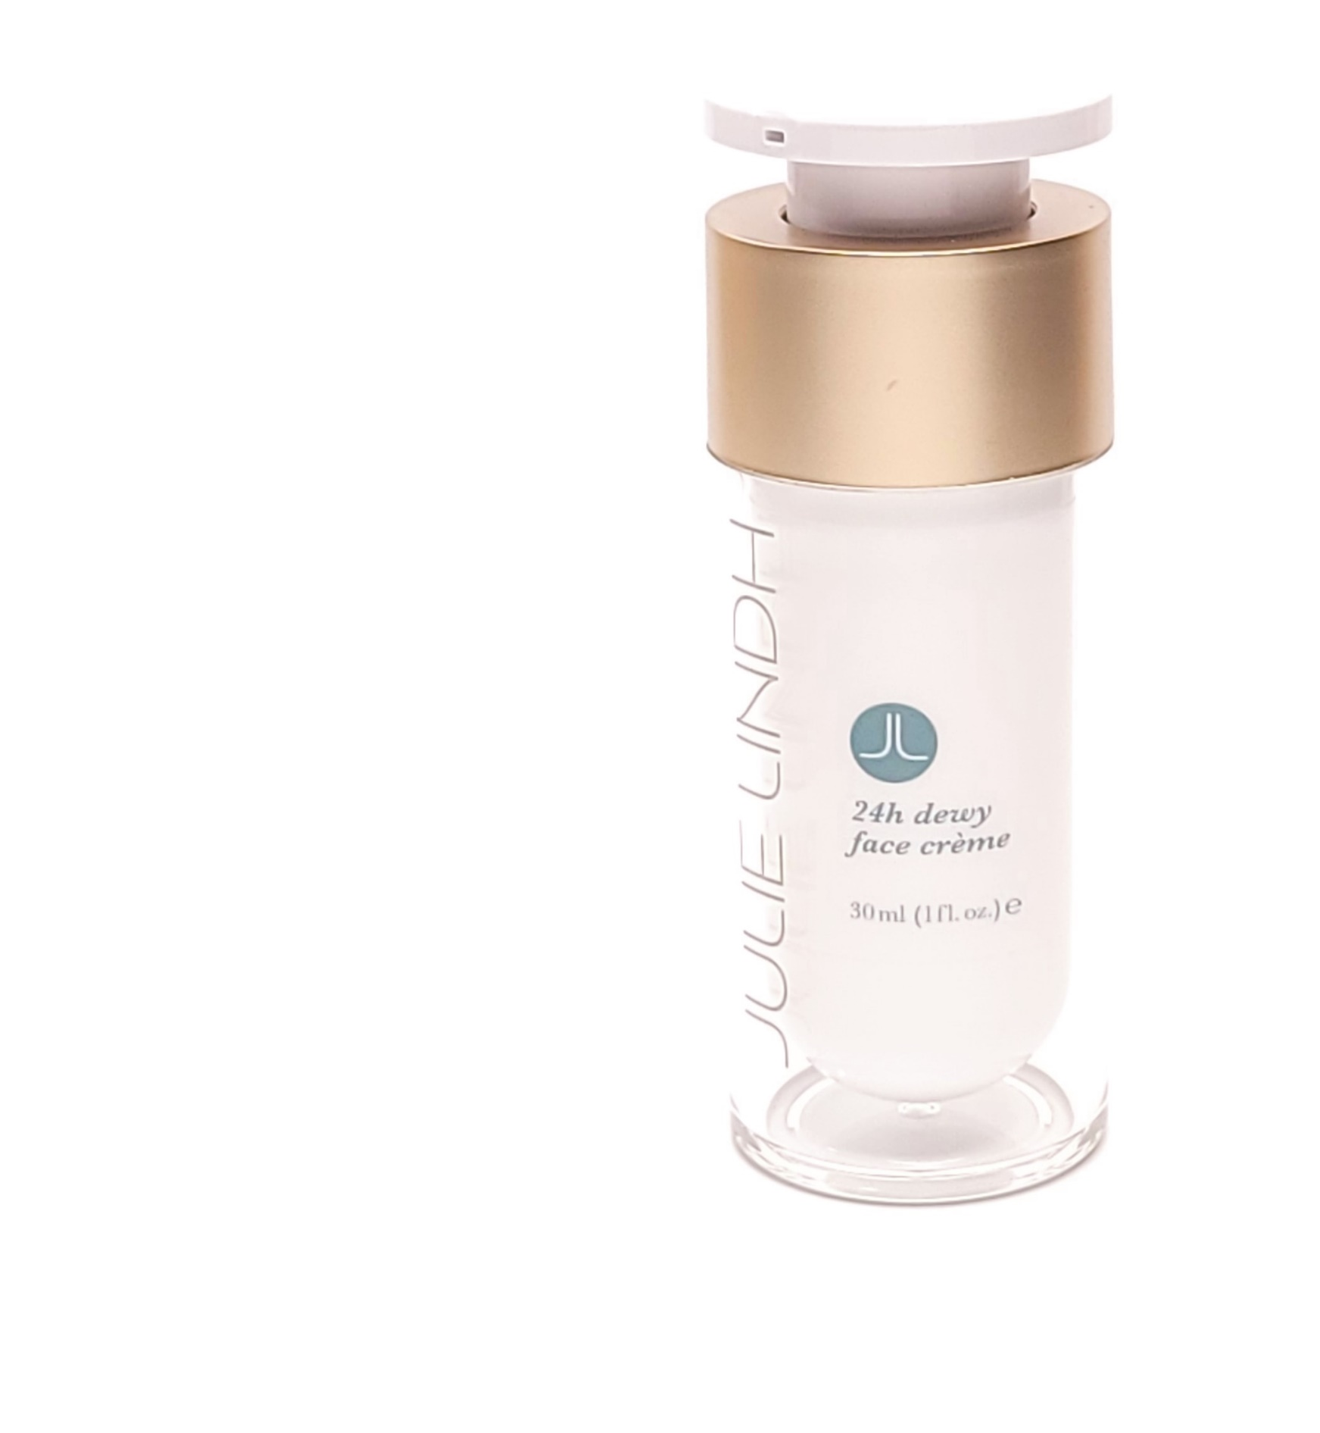
24H DEWY FACE CREME
Size: Travel size - 5ml Full size - 30ml
Vitamins A, B5, C & E
Fights free radical and tissue damaged.
Organic jojoba oil
Rich in Iodine, which fights harmful bacteria growth that leads to breakouts. The antioxidants present in jojoba oil soothe fine lines, wrinkles and anti-inflammatory.
Avocado oil
Rich in fatty acids and is excellent for moisturizing the skin. In addition to vitamin E, avocado oil contains potassium, lecithin, and many other nutrients that can nourish and moisturize the skin.
Rosehip seed oil
Rich in Vitamin A and essential fatty acids. Two vital components of Rosehip Seed Oil are Linoleic and Linolenic Acids, which play an important role in nourishing the skin.
‘If you are looking for a crème that makes skin looking radiant and dewy, this is the crème. Its also perfect under make up.’
~Julie
An all-natural moisturizer that provides the skin with the ingredients it needs to maintain a healthy, glowing appearance.
Perfect for stressed out skin, or skin that’s dry, dull or damaged
Contains omega-3 and omega-6 fatty acids and vitamins A, B5, C & E
Antioxidant booster with Vitamin C
Protects and hydrates

Slide 26
24H DEWY FACE CREME
Size: Travel size - 5ml Full size - 30ml
An all-natural moisturizer that provides the skin with the ingredients it needs to maintain a healthy, glowing appearance. What it is: The 24H Dewy Face Creme is perfect for sensitive or stressed-out skin that's dry, dull or damaged. This velvety-rich lotion is formulated to help soften the appearance of wrinkles for firmer, more supple skin while also improving the skin’s moisture barrier. What it does: This creme contains omega-3 and omega-6 fatty acids and vitamins A, B5, C & E that work together to make the skin look healthy and radiant. Omega-3 and Omega-6 oils are essential fatty acids that are necessary for skin to be its healthiest. This lotion also contains Vitamin C, an antioxidant booster that helps skin stay healthy and radiant, organic aloe leaf juice that works as an anti-inflammatory, rosehip seed oil that prevents signs of aging, avocado fruit oil that works as an antioxidant and helps to heal the skin, and organic jojoba seed oil that soothing the skin and acts as an anti-bacterial agent. Who’s it for: ✔ Normal skin ✔ Oily skin ✔ Combination skin ✔ Sensitive skin How to use: After cleansing, apply a thin layer of creme to the face and neck. Use with Miss Julie Skin Potion or V-Nutrient Serum for an added glow. Ingredients: Aloe barbadensis (Organic Aloe Leaf) Juice, Persea gratissima (Avocado) Fruit Oil, Simmondsia chinensis (Jojoba) seed Oil, Cetearyl Olivate, Sorbitan Olivate, Cetyl Palmitate, Sorbitan Palmitate, Shorea (Sal) Butter, Stearic Acid, Cocos Nucifera (Organic Coconut) Oil, Rose Distillate, Kosher Vegetable Glycerin, Tocopherol (Natural Vitamin E), Lonicera caprifolium (Honeysuckle) flower extract, Lonicera japonica (Honeysuckle) flower extract, Rosa canina (refined Rosehip) Seed Oil, Triticum vulgare (Wheat Germ) Oil, Tetrasodium Glutamate Diacetate, Daucus carota (Carrot) seed oil, Salix alba (Organic White Willow) Bark Extract, Organic Grape Alcohol (and) Sambucus nigra (Elderberry) Extract, Xanthan Gum, Rosmarinus officinalis (Organic Rosemary) Leaf Extract, Azadirachta indica (Organic Neem) Seed Oil, Allantoin, Sodium Hyalurate (Hyaluronic Acid), Retinyl Palmitate (Vitamin A Palmitate), Ascorbyl Palmitate (Vitamin C Ester), DL-Panthenol (Provitamin B5), Essential oil of Pelargonium graveolens (Geranium), Citrus bergamia (FCF Bergamot), Lavandula angustifolia (Lavender), Boswellia carterii Birdwood (Frankincense), Citrus aurantium (Neroli) flower, Jasminum officinale var. grandiflorum (Jasmine Absolute), Matricaria chamomilla (German Chamomile), Anthemis nobilis (Roman Chamomile), Foeniculum vulgare (Sweet Fennel), Daucus carota (Carrot) seed, and Rosa damascene (Rose) absolute.
Caution: Discontinue use if irritation occurs or if you are allergic to the ingredients listed. For external use only.

Slide 27
NOURISHING FACE SERUM
Size: Travel size - 5ml Full size - 30ml
CoQ10
Vitamin-like nutrient that acts as a powerful antioxidant. It helps reduce free radical damage that which occurs from UV rays. Support skin elasticity, reduce dark spots and wrinkles.
Alpha lipoic acid
Anti-inflammatory properties to reduce redness, blothiness and rejuvenate the skin in cellular level.
Hyaluronic acid
Antioxidant properties. Hydrating, calming skin irritation, and rapid wound healing and dermatitis.
Vitamins A, B5, C & E
Fights free radical and tissue damaged.
Vegan DMAE
Helps to tighten skin and reduce sagging, improve firmness and elasticity, smooth lines and wrinkles and also brighten the skin.
“This serum is like taking vitamin supplements topically for your skin. Great for men because of its light texture and great as final product before SPF in treatment room.” ~Julie
An ultra-moisturizing serum packed with nutrient-rich ingredients and vitamins that help to firm and tone skin.
Super-packed with antioxidants and vitamins
Increases collagen production
Brightens, softens and firms

Slide 28
NOURISHING FACE SERUM
Size: Travel size - 5ml Full size - 30ml
An ultra-moisturizing serum packed with nutrient-rich ingredients and vitamins that will help to firm and tone your skin. What it is: Super-packed with antioxidants, vitamins, and many more all-natural ingredients, the Nourish Face Serum rejuvenates skin and boosts the life of healthy skin cells. This serum combats the visible signs of aging by boosting collagen production, while also brightening, softening and firming skin. What it does: The all-natural ingredients in this serum work together to provide a ton of moisture to the skin, tones and firms the skin, and boosts collage production. With daily use, you will notice your skin looking more youthful, radiant and glowing. Who’s it for: ✔ Normal skin ✔ Oily skin ✔ Combination skin ✔ Sensitive skin How to Use: After cleansing, apply 2 pumps of the serum to the face and neck. Ingredients: Rose Distillate, Aloe barbadensis (Organic Aloe Leaf) Juice, Limnanthes alba (Meadowfoam) Seed Oil, Kosher Vegetable Glycerin, Cetearyl Olivate, Sorbitan Olivate, Cetyl Palmitate, Sorbitan Palmitate, Lonicera caprifolium (Honeysuckle) flower extract, Lonicera japonica (Honeysuckle) flower extract, Tocopherol (Natural Vitamin E), Tetrasodium Glutamate Diacetate, Dimethylaminoethanol Bitartrate (DMAE), Xanthan Gum, Daucus carota (Carrot) seed oil, DL-Panthenol (Provitamin B5), Organic Grape Alcohol, Ricinus communis (Castor) Oil, Lecithin (from Sunflower), Beta Carotene (Provitamin A), Retinyl Palmitate (Vitamin A Palmitate), Niacinamide (Vitamin B3), Magnesium Ascorbyl Phosphate (Vitamin C), Ubidecarenone (Coenzyme Q10), Thioctic Acid (Alpha Lipoic Acid), Essential oils of Pelargonium graveolens (Geranium), Lavandula angustifolia (Lavender), Foeniculum vulgare (Sweet Fennel), Citrus bergamia (FCF Bergamot), Citrus aurantium (Neroli) flower, Jasminum officinale var. grandiflorum (Jasmine Absolute), Daucus carota (Carrot) seed, Matricaria chamomilla (German Chamomile), Anthemis nobilis (Roman Chamomile), and Rosa damascene (Rose) absolute.
Caution: Discontinue use if irritation occurs or if you are allergic to the ingredients listed. For external use only. Avoid eye area.

Slide 29
CALM SKIN SERUM with Elderflower & CBD
Size: Travel size - 5ml Full size - 30ml
“This serum is a must have in every treatment room. Amazing post peel and final product application.
It is hydrating enough to use as a moisturizer for those who have oilier and acne skin. It won't clog your pores and leave a thin barrier. If you have irritation and redness, use this with the Elderflower Facial Essence.
~Julie
Elderflower Extract
Rich in vitamins, flavonoids and quercetin. It helps reduce free radical damage that which occurs from UV rays. Support skin elasticity, reduce dark spots and wrinkles.
Honeysuckle Flower Extract
Rich in flavonoids and anti-inflammatory properties to reduce redness, eczema, acne and skin irritational.
Hyaluronic acid
Antioxidant properties. Hydrating, calming skin irritation, and rapid wound healing and dermatitis.
Rosehip seed oil
Rich in Vitamin A and essential fatty acids. Two vital components of Rosehip Seed Oil are Linoleic and Linolenic Acids, which play an important role in nourishing the skin.
An antioxidant serum with healing Elderflowers and aging prevention CBD to help repair and make skin younger.
Super-packed with antioxidants and vitamins
Increases collagen production
Brightens, softens and firms

Slide 30
CALM SKIN SERUM with Elderflower & CBD
Size: Travel size - 5ml Full size - 30ml
An ultra-moisturizing serum packed with nutrient-rich ingredients and vitamins that will help to firm and tone your skin. What it is: A highly antioxidant and anti-inflammatory face serum with Elderflowers, Honeysuckle flower extract, and aging prevention CBD to help repair, calming and make skin less irritated.
What it does: The CALM Face Serum was formulated to address skin irritation, acne rosacea, redness from dryness, and dermatitis skin. It has soothing natural ingredients to instantly calm and reduces inflammation. Can be used as a moisturizer if you have oily and acne skin. Who’s it for: ✔ Normal skin ✔ Oily skin ✔ Combination skin ✔ Sensitive skin How to Use: After cleansing, apply 2 pumps of the serum to the face and neck. Ingredients: Aqua (Water), Sambucus nigra SSP (Elderflower) Distillate, Rosa canina (refined Rosehip) Seed Oil, Kosher Vegetable Glycerin, Cetearyl Olivate, Sorbitan Olivate, Cetyl Palmitate, Sorbitan Palmitate, Lonicera caprifolium (Honeysuckle) flower extract, Lonicera Japonica (Honeysuckle) flower extract, Cannabis Sativa (Industrial Hemp) CBD Distillate, Tetrasodium Glutamate Diacetate, Sodium Hyalurate (Hyaluronic Acid), Essential oils of Citrus Paradisi (Grapefruit) and Citrus Aurantium (Neroli) flower..
Caution: Discontinue use if irritation occurs or if you are allergic to the ingredients listed. For external use only. Avoid eye area.

Slide 31
BALANCE SKIN POTION with CBD
Size: Travel size - 5ml Full size - 30ml
Organic jojoba oil
Rich in Iodine, which fights harmful bacteria growth that leads to breakouts. The antioxidants present in jojoba oil soothe fine lines, wrinkles and anti-inflammatory.
Rosehip seed oil
Rich in Vitamin A and essential fatty acids. Two vital components of Rosehip Seed Oil are Linoleic and Linolenic Acids, which play an important role in nourishing the skin.
Chia Seed Oil
Great source of vitamin B3 and zinc, which helps with oily skin and clogged pores.
CBD IN SKIN CARE
Amazing anti-inflammatory, antioxidant, and antibacterial properties. Due to its unique and potent properties, CBD oil can help to reduce the appearance of fine lines and wrinkles and improve irritating skin conditions such as acne, rosacea, eczema, dry skin, and psoriasis.
‘It’s called Balance for a reason. This oil has a unique formula. It helps those with superficial dehydration, dry and oily skin.
For flare-up, redness, itchy and even sunburn, apply this oil on the area and cover with a cold towel. It gives immediate relief and the skin begins to repair. It is an amazing oil that is multi-purpose.” ~Julie

Slide 32
SKIN BALANCING POTION with CBD
Size: Travel size - 5ml Full size - 30ml
The hydrating, rejuvenating, healing and repairing properties of Balance Skin Potion are boosted by the antioxidant, anti-inflammatory, anti-aging and soothing properties of Cannabis Oil, making this our most potent Skin Potion yet!
What it is:
The BALANCE Skin Potion has many surprising health benefits, especially for the skin. So many in fact that it’s being touted as the latest "super beauty ingredient.” Not only can this oil help to reduce the appearance of fine lines and wrinkles and improve irritating skin conditions such as acne, rosacea, eczema, dry skin and psoriasis, it’s also incredibly soothing and deeply hydrating.
What it does:
It rejuvenates the skin and stimulates cell regeneration giving you a healthier, more youthful look. Restore your skin’s natural glow and prevent signs of aging with this truly amazing oil. It’s so good it’s almost super-natural!
Who’s it for:
✔ Normal skin ✔ Oily skin ✔ Combination skin ✔ Sensitive skin
How to use:
After cleansing, rub a few drops of the potion all over the face and neck twice daily (morning and night). Do not ingest. Avoid during pregnancy.
The Julie Lindh CBD Difference:
Our CBD supplier is one of the largest producers and distributors of high-quality medicinal hemp in the United States. The CBD we use is certified organic and extracted via CO2 instead of with harsh chemicals. Our CBD is also “full-spectrum,” meaning we utilize the whole plant without removing or destroying any parts. Using the whole plant ensures that the CBD oil contains other important cannabinoid compounds such CBG, CBGA, CBG, CBC, CBGV, THCV and CBCV.
These compounds work together to make full-spectrum CBD oil much more beneficial than CBD isolate alone.
Ingredients:
Rosa canina (refined Rosehip) Seed Oil, Salvia hispanica (Chia) Seed Oil, Simmondsia chinensis (Jojoba) seed Oil (and) Sambucus nigra (Elderberry) Extract, Citrus paradisi (Grapefruit) essential oil, Cannabis sativa (Industrial Hemp) CBD Distillate, essential oils of Pelargonium graveolens (Geranium), Salvia sclarea (Clary Sage), Boswellia carterii Birdwood (Frankincense), Cistus ladanifer (Cistus), Citrus limon (Lemon), Cedrus deodora (Cedarwood), Lavandula angustifolia (Lavender), Pogostemon cablin (Patchouli), Calendula officinalis (Calendula) CO2 Extract, and Daucus carota (Carrot) seed oil.
Caution: Discontinue use if irritation occurs or if you are allergic to the ingredients listed. For external use only. Avoid eye area.

Slide 33
GLOWING SKIN BODY OIL
Size: Travel size - 30ml Full size - 120ml
“Amazing oil to use in a body treatment. After dry brushing, massage this oil in with a baker twist massage, then infrared wrap. Client will sweat more and skin feels very hydrated” ~Julie
Organic jojoba oil
Rich in Iodine, which fights harmful bacteria growth that leads to breakouts. The antioxidants present in jojoba oil soothe fine lines, wrinkles and anti-inflammatory.
Rosehip seed oil
Rich in Vitamin A and essential fatty acids. Two vital components of Rosehip Seed Oil are Linoleic and Linolenic Acids, which play an important role in nourishing the skin.
Essential Oils Blend of Pink Grapefruit, Geranium, Juniper, Rosemary, Fennel, Citrus, Chamomile, Lavender, Bergamot.
Together they promote blood circulations, relieve water retention and detoxifying. Great for cellulite and skin firming.
Deeply luxurious mix of nourishing essential oils
for soothing and hydrating the skin
Multi-use oil with beautiful light scent
Long-lasting hydration
Fast absorbing without feeling greasy

Slide 34
GLOWING SKIN BODY OIL
Size: Travel size - 30ml Full size - 120ml
A deeply luxurious mix of nourishing essential oils for soothing and hydrating the skin. What it is: This multi-use oil is ultra-moisturizing, hydrating and has a beautiful light scent. It can be used on the entire body or in the bath. Formulated with a blend of pure botanical oils including rosehip seed and jojoba, this luxurious oil sinks into your skin leaving it deeply nourished and feeling super soft. What it does: Formulated with a botanically active blend of powerhouse oils, this formula nourishes the skin leaving it feeling velvety soft, moisturized and looking healthier and more radiant. Jojoba oil soothes the skin and has anti-bacterial properties. Rosehip oil is packed-full of vitamins that repair damaged skin and prevents signs of aging. Pink grapefruit oil increases lymphatic flow while juniper oil detoxifies and helps to increase circulation. This oil is fast absorbing, never feels greasy, and is great for all skin types. After just one use your skin will look glow-y and luminous. Who’s it for: ✔ Normal skin ✔ Oily skin ✔ Combination skin ✔ Sensitive skin How to use: Put one pump of oil into the palms of your hands and rub all over the body in an upwards motion until well absorbed. For best results, use after a shower or bath. You can also put a pump or two of this oil into a warm bath for a relaxing soak. Ingredients: Rosehip Seed Oil, Jojoba Oil, Essential Oils of Pink Grapefruit, Geranium, Juniper, Rosemary, Fennel, Citrus, Chamomile, Lavender, Bergamot
Caution: Discontinue uses if irritation occurs or if you are sensitive to the ingredients listed. For external use only.

